Slide 1

RAJEEV GANDHI COLLEGE OF MANAGEMENT STUDIES
“STUDY ON EFFECTS OF NATURAL DISASTERS ON SOCIETY”
A PROJECT SUBMITTED IN THE PARTIAL FULFILLMENT OF
THE REQUIREMENT FOR THE AWARD OF
THE DEGREE OF MASTER IN MANAGEMENT STUDIES (MMS)
SUBMITTED BY:
RAJDEEP CHAKRAVORTY
Roll No- 77
MMS – SEM 4
Batch : 2019-2021

Slide 2
Problem Identification
The focus of this report is on characterizing impacts of natural disasters such as extreme precipitation events and floods on households and businesses in the selected locations. To understand flood impacts, it is necessary to understand the nature of the hazard—in this case extreme rainfall—and assess factors that expose people and assets to floods and contribute to their vulnerability.
After evaluating the nature of the flood risk in the three locations, this report focuses on the impacts on households, retail businesses, and SMEs using field-level and secondary data.

Slide 3
INTRODUCTION
Disasters can be mainly categorised as – natural and man-made. Mother Nature has always been at the giving end. However, she can be equally devastating, highly destructive, and unforgiving at the same time. A natural disaster is a major adverse event resulting from natural processes of the Earth
TYPES OF NATURAL DISASTERS
Flood
Hurricanes
Earthquake
Volcanic Eruption
Landslide
Tsunami
Drought
Avalanches

Slide 4
RESEARCH METHODOLOGY
Type of Research Design: Descriptive Research
Data collection method : Secondary Data
The study is based on secondary data. The first step was to gather all the data in one place. After this all the relevant data was put together. The different blogs and new sites which make any mention of the merger and acquisitions has been used. All the data collected was organized into a systematic presentation deck.
Sources include Websites, Online Journals, News Articles, Magazines, Research papers etc

Slide 5
OBJECTIVES OF STUDY
Following are the objectives of the study:
To study the different types of Natural disasters.
To understand the nature of the disasters and its effects on society
To improve the understanding of disaster risk, hazards and vulnerabilities.
To enhance disaster preparedness for effective response, and form mitigation strategies.

Slide 6
LIMITATION OF STUDY
In the course of the study, some challenges were encountered that limited the research in one way or another and some of them are as follows so that the findings of the study are understood in proper perspective.
The limitations to the study are as follows:
The first and foremost important limitation was time constraint.
The subject of this project is quite vast and deep so it is very difficult to cover every aspect of the topic.
The study was region specific.

Slide 7
DATA ANALYSIS
Profile of Surveyed Wards in Mumbai
Ward | Area (km²) | Residential Area (km²) | Residential Density | Total HHs | Slum HHs | % of Slum HHs | Number of HHs Surveyed
F North | 12.01 | 4.03 | 131,411 | 132,259 | 61,680 | 46.6 | 177
F South | 9.65 | 2.34 | 154,380 | 90,243 | 19,040 | 21.1 | 103
H East | 12.89 | 2.83 | 199,280 | 140,861 | 48,201 | 34.2 | 176
K East | 24.00 | 6.85 | 120,200 | 205,971 | 80,760 | 39.2 | 241
L Ward | 15.56 | 5.45 | 165,573 | 225,556 | 98,080 | 43.5 | 231
P North | 46.72 | 10.27 | 91,645 | 235,342 | 100,900 | 42.9 | 240

Slide 8
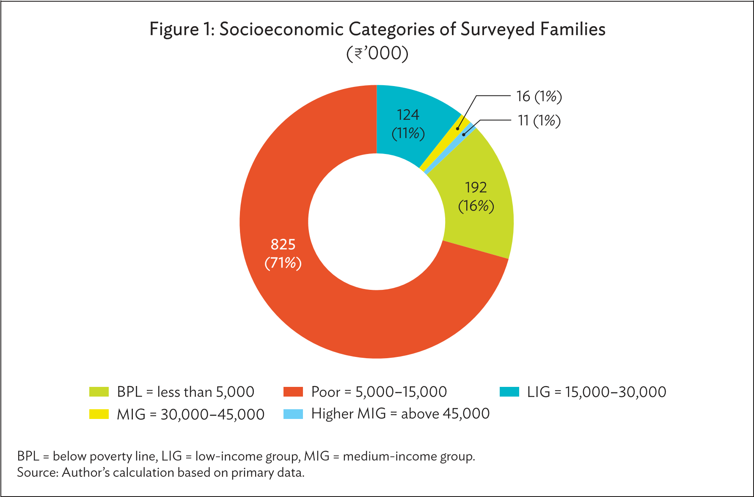
DATA ANALYSIS
Most (87%) of these households owned the houses they lived in and had invested their earnings and life savings to build their asset base. During the extreme floods of 2005, the average flood depth was 5 feet, and in some areas, it reached a depth of 8 feet thus destroying their houses

Slide 9
DATA ANALYSIS
Estimated Repair or Replacement Cost of Damage
Socioeconomic Category | House Repair | HH Appliances | HH Assets | Vehicles | Total Damage Cost | Share of Average Monthly Income (%)
Below poverty line | 15,000 | 11,000 | 6,700 | 6,500 | 37,000 | 1,480
Poor | 22,000 | 13,000 | 7,000 | 9,000 | 48,000 | 480
Low-income group | 30,000 | 14,000 | 10,000 | 10,000 | 57,000 | 253
Medium-income group | 45,000 | 17,000 | 13,000 | 2,500 | 69,000 | 184
Higher-medium income group | 40,000 | 19,000 | 8,500 | 5,000 | 69,000 | 115

Slide 10
DATA ANALYSIS
INTERPRETATION
Most families received no flood warning. In some cases, by the time warning was issued, floodwaters had already risen and people could not move to higher ground in time and protect important assets and documents. Those who could not move to a safer place waited on top floors or roofs for rescue and relief material. Airdropped relief packages often became scattered and people could not access and use them. In some areas, relief material and rescue boats reached houses located along the roads, but those living in the interior parts of affected neighborhoods remained without assistance.

Slide 11
FINDINGS
A natural disaster can cause loss of life or damage property, and typically leaves some economic damage in its wake, the severity of which depends on the affected population's resilience and on the infrastructure available.
Earthquakes, cyclones, volcanic eruptions and floods are some of the hazards we live with. But we can lessen the impacts of these hazards on our lives and livelihoods by following Disaster Risk Reduction (DRR) strategies. These strategies help societies prepare and respond to hazards, and therefore reduce the associated risks to vulnerabilities.
The disaster preparedness is the main weapon against the disaster may it be before, during and after a disaster and this can be enhanced by forming effective mitigation strategies.

Slide 12
SUGGESTIONS
Disaster management organizations should take advantage of opportunities for adoption of existing technology or adjustment of policies and procedures that would allow significant short-term enhancement of disaster management.
The federal government should do more to prepare for the projected frequency of severe disasters, such as improving interagency coordination and providing more realistic budgeting for disasters.
More awareness should be spread out in both the rural and urban areas. The people should be imparted the knowledge of the dos and don’ts, the precautionary measures and the mitigation strategies.

Slide 13
CONCLUSION
Floods account for more than half of climate-related disasters in India and cause damages of $54.63 billion during 1990–2017. Global warming and climate change are expected to increase the frequency and intensity of these disasters.
Mean annual rainfall and extreme single-day rainfall events are also projected to increase in frequency and intensity. The scale of the impacts of these extreme events on people and ecological systems depends on vulnerability and exposure.

Slide 14


